Slide 1
2. REQUIREMENTS DEVELOPMENT 2.18 Requirements REUSE
Software requirement engineering (Undergraduate)

Slide 2
Why reuse requirements?
Faster delivery
Lower development costs
Consistency both within and across applications
Higher team productivity
Fewer defects
Reduced rework
Save review time
Accelerate the approval cycle
Speed up other project activities, such as testing
Improve your ability to estimate implementation effort if you have data available from implementing the same requirements on a previous project.
Improve functional consistency across related members of a product line or among a set of business applications.
Saves time for stakeholders, who then will not need to specify similar requirements repeatedly.

Slide 3
Dimensions of requirements reuse

Slide 4
Requirement Evolution

Slide 5
Types of requirements information to reuse

Slide 6
Common reuse scenarios
Software product lines
a set of products in a family = a software product line
Reengineered and replacement systems
Other likely reuse opportunities (next slide)

Slide 7
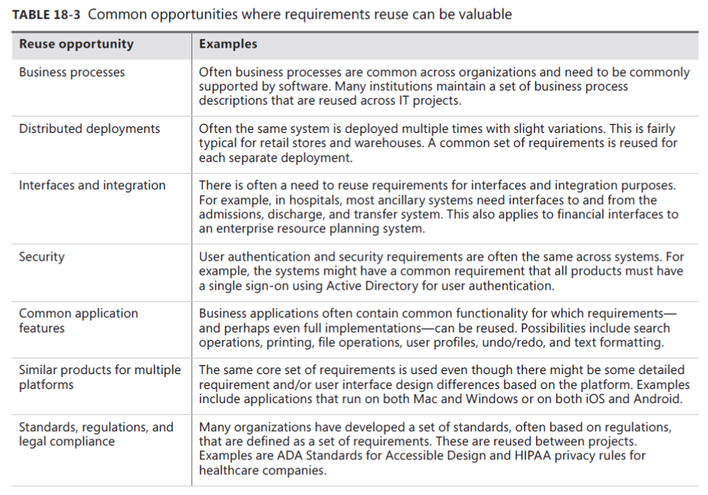
Other likely reuse opportunities

Slide 8
Requirement patterns
A requirement pattern contains several sections:
Guidance Basic details about the pattern, including related patterns, situations to which it is (and is not) applicable, and a discussion of how to approach writing a requirement of this type.
Content A detailed explanation of the content that such a requirement ought to convey, item by item.
Template A requirement definition with placeholders wherever variable pieces of information need to go. This can be used as a fill-in-the-blanks starting point for writing a specific requirement of that type.
Examples One or more illustrative requirements of this type.
Extra requirements Additional requirements that can define certain aspects of the topic, or an explanation of how to write a set of detailed requirements that spell out what must be done to satisfy an original, high-level requirement.
Considerations for development and testing Factors for developers to keep in mind when implementing a requirement of the type specified by the pattern, and factors for testers to keep in mind when testing such requirements.

Slide 9
Reuse barriers
Missing or poor requirements
NIH and NAH:
NIH means “not invented here”
NAH, or “not applicable here”
Writing style
Inconsistent organization
Project type
Ownership

Slide 10
Reuse success factors
Repository
A single network folder that contains previous requirements documents
A collection of requirements stored in a requirements management tool that can be searched across projects
A database that stores sets of requirements culled from projects for their reuse potential and enhanced with keywords to help future BAs know their origin, judge their suitability, and learn about their limitations
Quality
Interactions
Terminology
Organizational culture

Slide 11

END OF
LECTURE.

